Slide 1
HEALTH CENTRE MANAGEMENT SYSTEM
TEAM MEMBERS:-
DIKCHA SINGH (RA2011027010096)
AKAASH RAM (RA2011027010126)
K SANTHANA LAKSHMI (RA2011027010129)

Slide 2
ABSTRACT:
The Project describes the healthcare management system. This report will help you to know in depth the actual work that has been done as a team work. The main objective of this application is to automate the complete operations of healthcare. They need to maintain hundreds of thousands of records. Also searching should be very fast, so they can find required details instantly. This system is intended to provide information about the availability of infrastructure required in hospitals like oxygen cylinder, beds in emergency conditions at their respective locations. Main objective is to create a system which helps the Hospital employees to complete their work faster in a simple way by using a computer, not the oldest way which is using paper.

Slide 3
LIST OF GENERAL AND UNIQUE SERVICES IN DATABASE APPLICATION:
Hospital Employees can update,edit,delete the database and the values in the database.
They can maintain the database up to date.
Patients can view the details of the availability of infrastructures in the hospital by the help of a database.

Slide 4
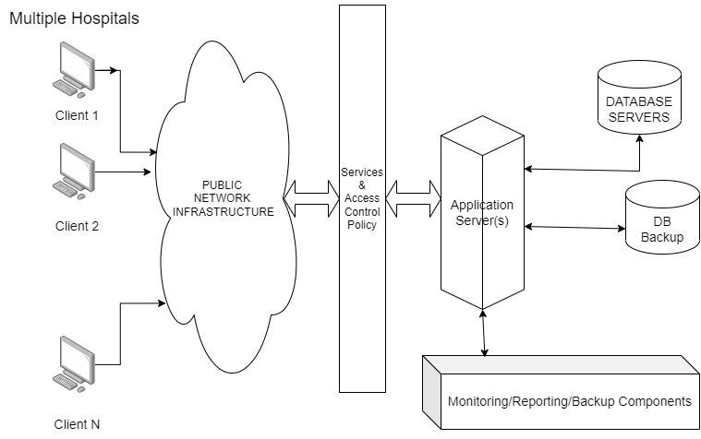
ARCHITECTURE DIAGRAM:

Slide 5
EXPLANATION:
multiple clients as users (i.e patients and hospital employees) access the front end used by patients or users for accessing the availability of beds and oxygen cylinders.
hospital employees will update the database time to time and it will sync with the database servers and application servers.
Access control is concerned with determining the allowed activities of legitimate users, mediating every attempt by a user to access a resource in the system.

Slide 6
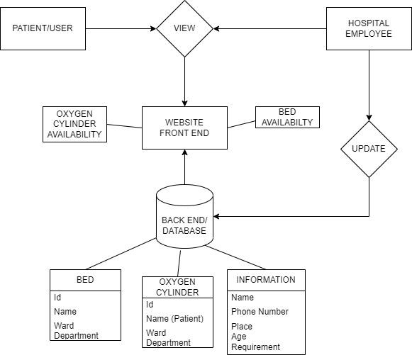
ER DIAGRAM:

Slide 7
EXPLANATION:
patient(user) and hospital employee view the website(front end) which displays the bed and oxygen cylinder availability in the hospital at the present moment.
hospital employees that manage the database can update time to time the availability of beds and oxygen cylinders.
The table information is updated by the employee after the patient registers at reception all the necessary details are updated.

Slide 8
FRONT END DESIGN AND SOFTWARE USED:
HTML - user interface page
CSS - Styling the page
Software - Visual Studio coding platform
EXPLANATION:
In Frontend we will create a form where patients fill in the details and in that they can see the required infrastructure details such as bed availability,oxygen cylinder availability etc.Once they submit the form it will retrieve from the database and display it to the patients the required information.

Slide 9
BACK END DESIGN AND SOFTWARE:
Backend - sql language
Software - mysql database
EXPLANATION:
In the Backend we will create a database where it collects all the information from the form which patients fill in the frontend.so that we will keep a track who searched for what details.also once the form submitted it will take to the next page where it shows the infrastructure availability to the patients by using database.

Slide 10
TYPE OF CONNECTIVITY USED FOR DATABASE ACCESS:
PHP mysqli_connect() function is used to connect with MySQL databases. It returns resources if connection is established or null.
Relational databases are used as a connectivity for database access.
It is used for storing and managing data.
Relational databases are based on the relational data model, which organizes data into tables with rows and columns. The relationships between tables are defined by foreign keys, which link records in one table to records in another. Relational databases use SQL (Structured Query Language) to access and manipulate data.

Slide 11
LIST OF MODULES AND FUNCTIONALITIES IN EACH MODULE:
View module:
In this module the user is the patient,employees both can view the details of the availability of infrastructure in the database.
Database Module:
In this module the employees of the hospital can maintain the database information where they will do updation,deletion of database records.

Slide 12
REFERENCES
[1]https://www.sciencedirect.com/topics/computer-science/database-connectivity
[2]https://www.adroitinfosystems.com/products/ehospital-systems
[3]https://www.edrawsoft.com/article/er-diagrams-for-hospital-management-system.html

